Slide 1

Data Analysis Project
Let’s go

Slide 2
Our team
Anas Mansour Hisham Mohamed Ahmed Emad Hossam Lofty Zeyad Ayman

Slide 3
Table of contents
01
Objectives & strategy
02
Proposed Solution
03
Limitations & Future Work
04
Implementation
Analyzing Movie Trends
Technologies Used and System Architecture
Future Enhancements and Research Directions for Movie Analysis
Some Screenshots to our project

Slide 4
W. Edwards Deming
“Without data, you’re just another person with an opinion..”

Slide 5
Objectives & Strategy
01
Analyzing Movie Trends and Predicting Success Using TMDB Movies Data

Slide 6
Objectives
Dataset
Analysis Focus
Goal
Data Features
Movie trends over the years
Key factors contributing to movie success
TMDB movies dataset.
Revenue
Genres
Ratings
Cast
Crew
Other relevant features.
Build a predictive model to forecast a movie's success based on the identified features.
Identify trends and factors that drive success.

Slide 7
Proposed Solution
02
Technologies Used and System Architecture

Slide 8
Problem Statement
Industry Context:
Problem:
Purpose:
Billions invested in movie production.
Predicting movie success is challenging.
Limited insights on how factors (e.g., budget, revenue, cast, runtime) contribute to movie performance.
Analyze historical data to identify success factors.
Develop a predictive model to assist producers in making informed decisions.

Slide 9
Innovative
fresh, groundbreaking ideas.

Slide 10
Proposed Solution
Technologies Used
System Architecture
Python (for data analysis)
Pandas and NumPy (for data manipulation)
Tableau (for data visualization)
SQL (for querying specific data points)
Data Import: Load the TMBD dataset from the CSV file.
Data Preprocessing: Clean and preprocess the dataset to handle missing values and inconsistencies.
Exploratory Data Analysis: Perform statistical analysis to uncover key insights related to character popularity, box office performance, and audience reception.
Reporting and Visualization: Use various charts, graphs, and tables to present the findings in a visually engaging way.

Slide 11
Limitations & Future Work
03
Future Enhancements and Research Directions for Movie Analysis

Slide 12
Limitations
D
Data Quality Issues
Missing values in key columns such as budget, revenue, and release year.
Incomplete data on older movies or small-budget films.
O
Outlier Impact
Presence of extreme values for budget and revenue, possibly skewing results.
Some blockbusters may distort trends due to unusually high figures.
D
Data Source Limitations
The dataset is from publicly available sources (TMDB) and may not represent the entire global film industry.
G
Genre Overlap
Some films belong to multiple genres, making it difficult to assign a primary genre for analysis.
S
Subjectivity in Ratings
Audience votes and ratings can be subjective and may not accurately reflect a movie's success.

Slide 13
Future Work
Expand Dataset:
Incorporate additional data sources industry coverage.
Improve Data Cleaning
Implement more advanced techniques for outlier detection and missing value handling, such as machine learning methods.
Incorporate Streaming Data
Analyze streaming platforms to assess their growing influence on the industry.
Sentiment Analysis
Include audience and critic reviews to provide more context on movie reception.
Predictive Models
Build models to predict future movie performance based on genre, director, and budget.

Slide 14
Implementation
04
Some Screenshots to our project

Slide 15
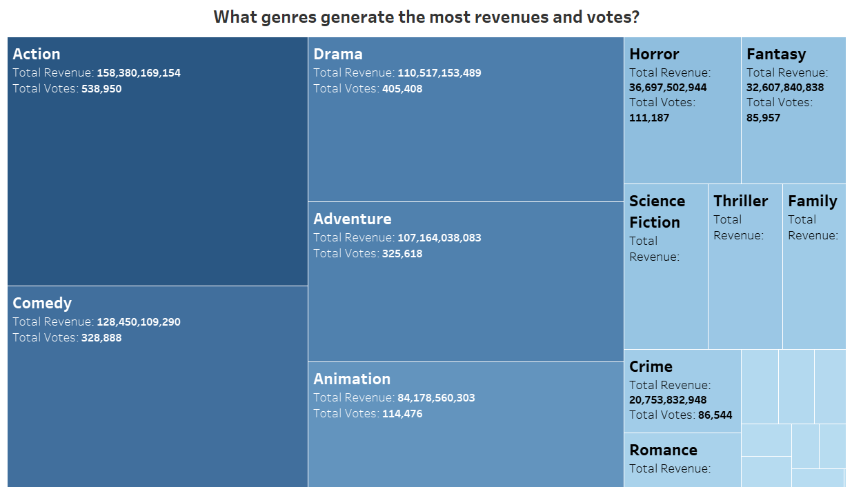

Slide 16
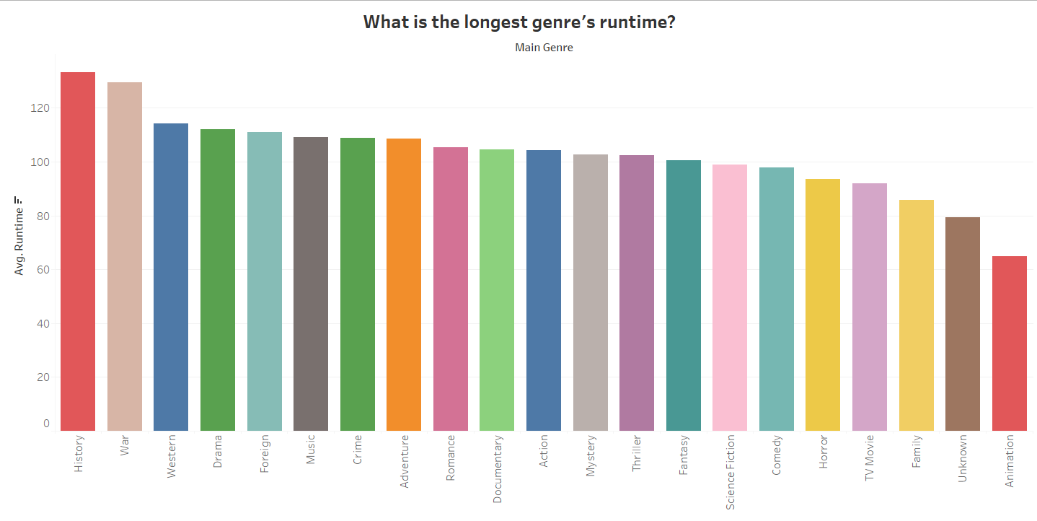

Slide 17
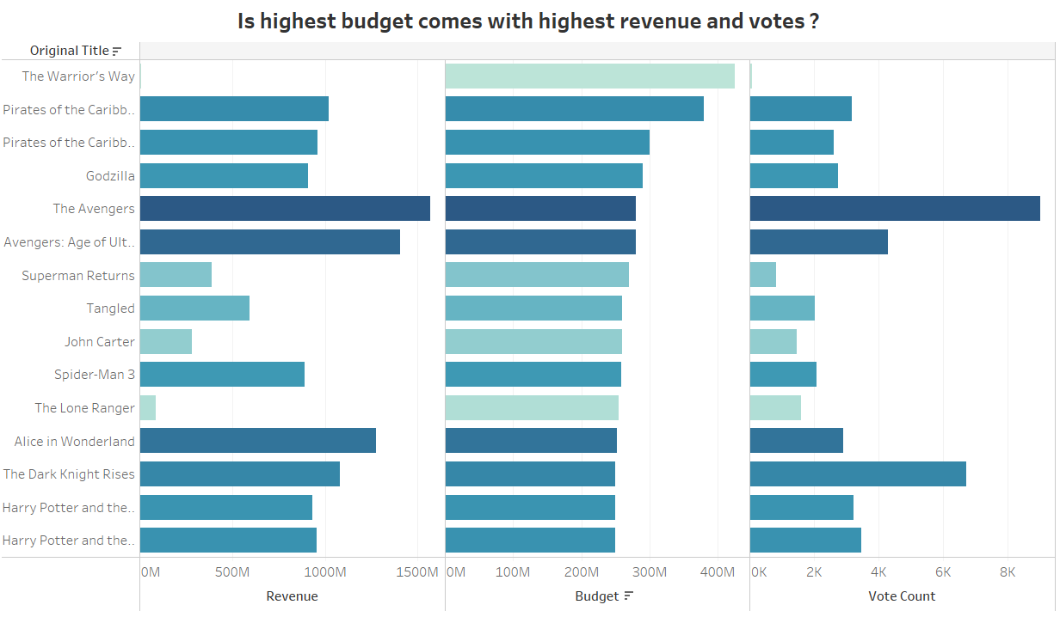

Slide 18
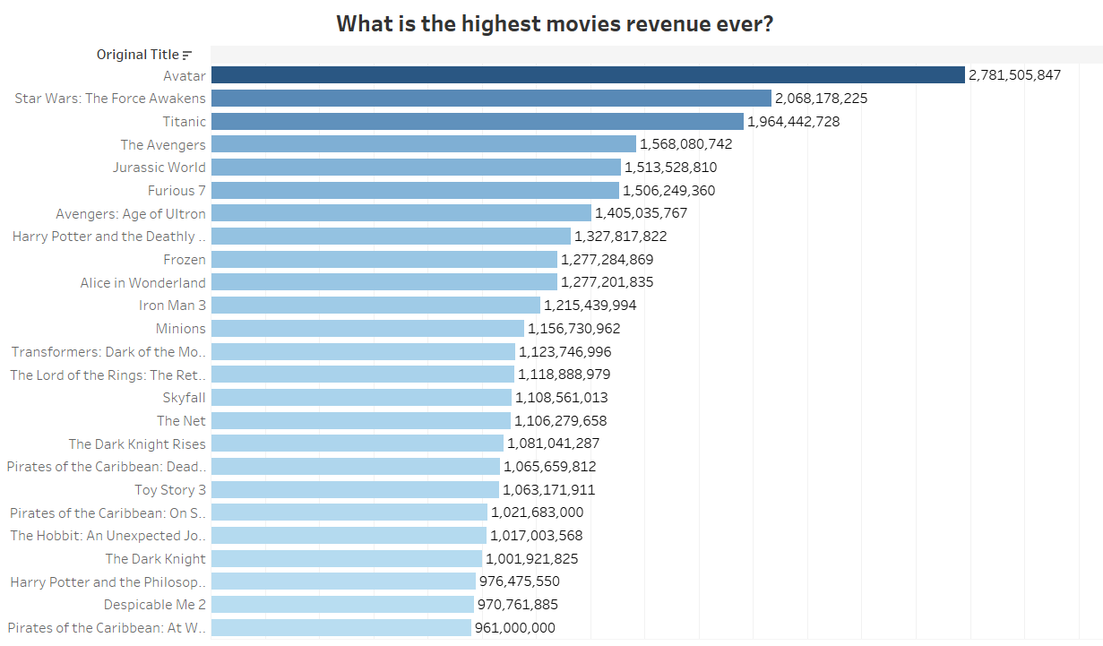

Slide 19
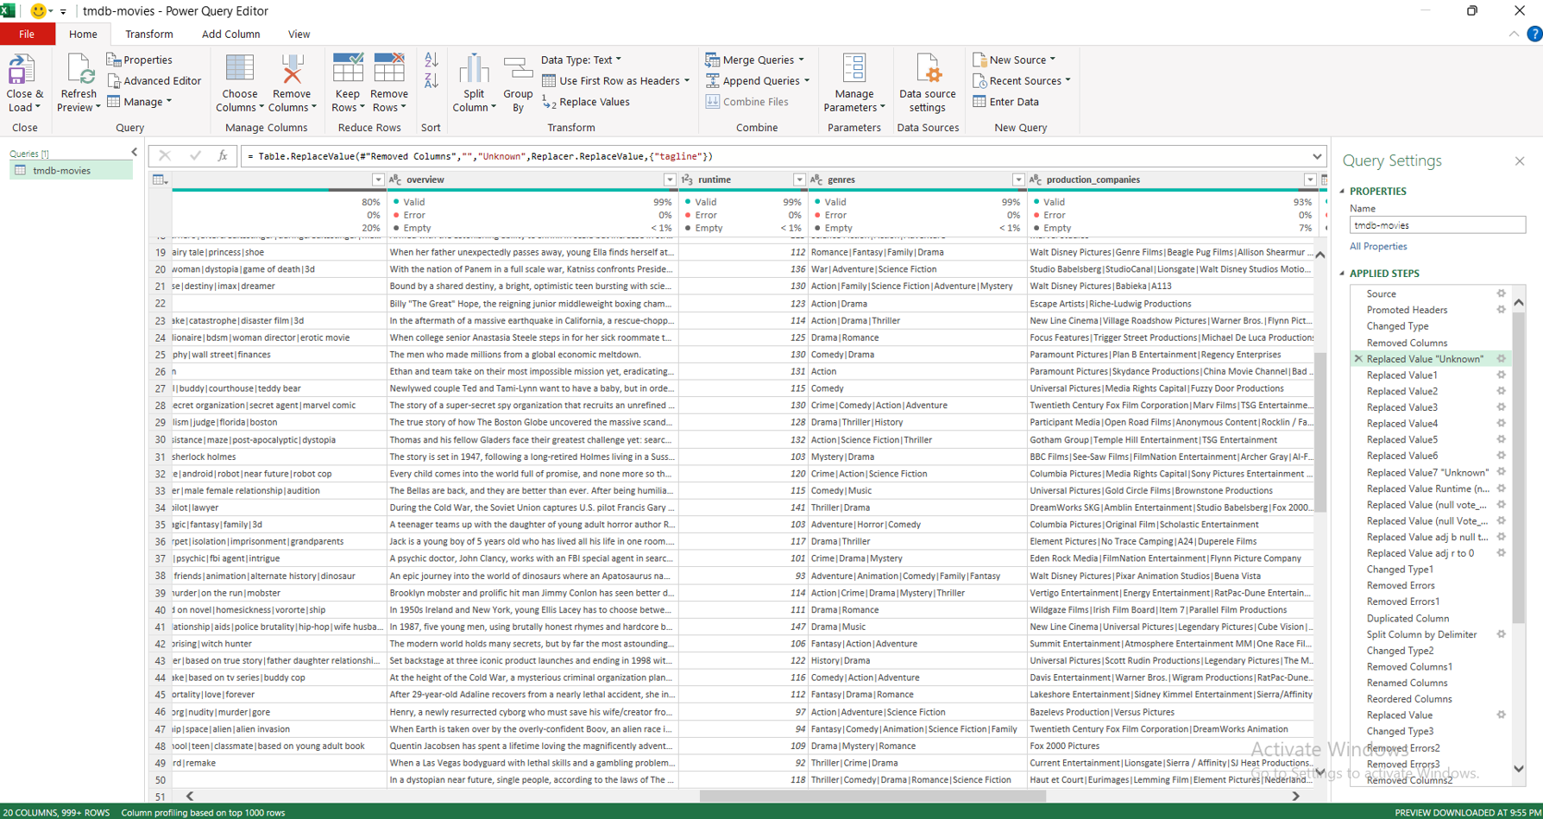
Here we Replace all Null data to Unknown

Slide 20
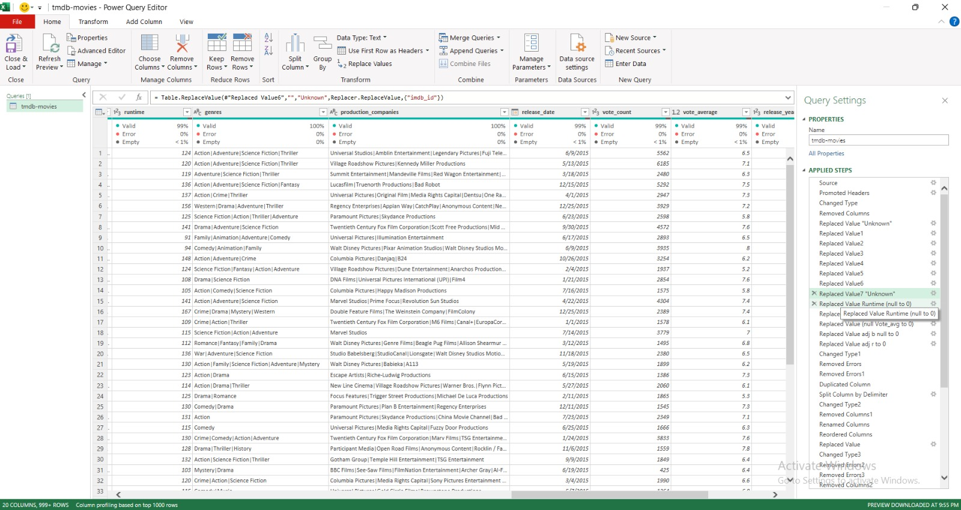
Here we Replace all Null data to 0

Slide 21
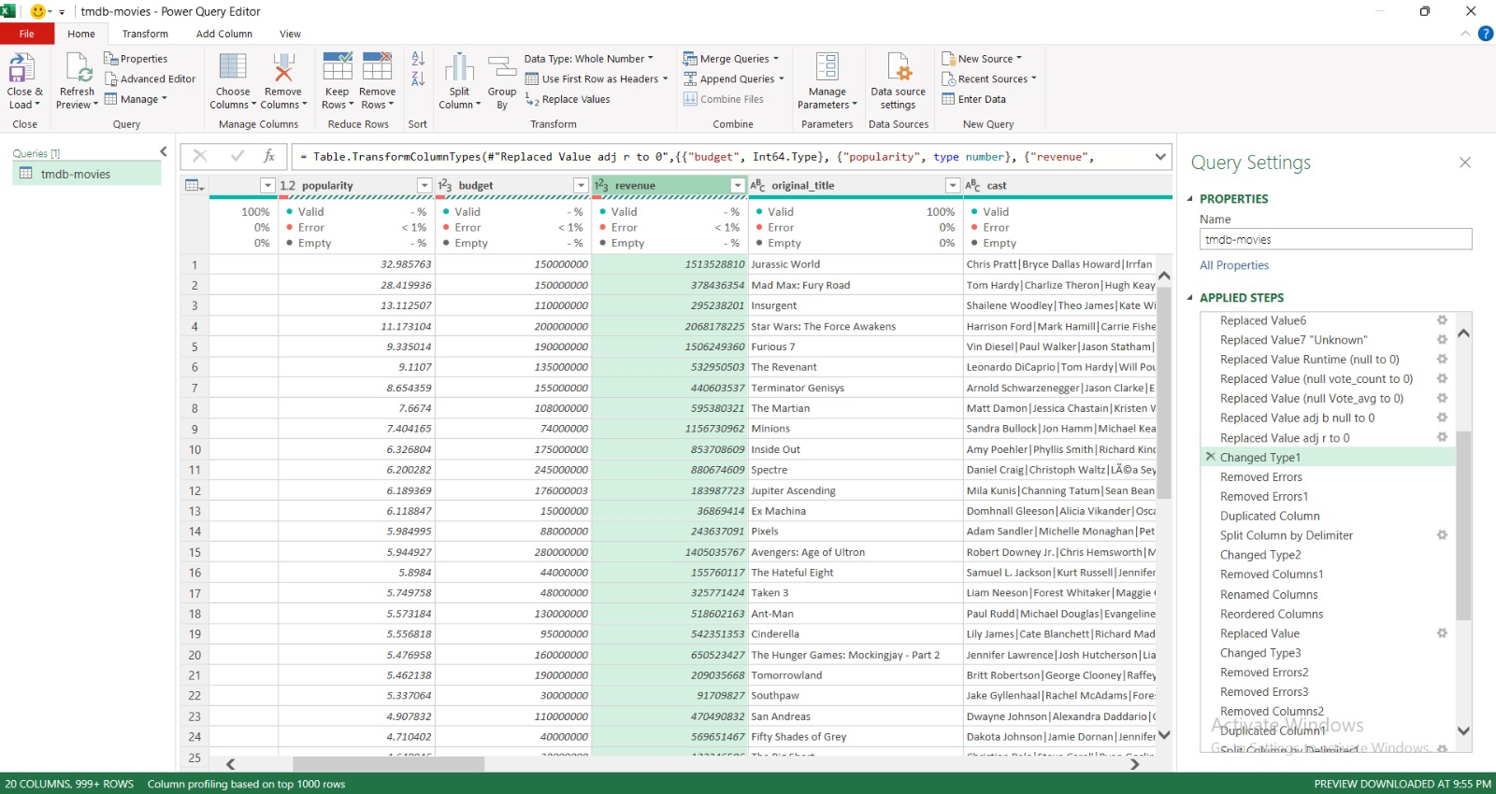
We handled the error occurred after changing the data type.

Slide 22
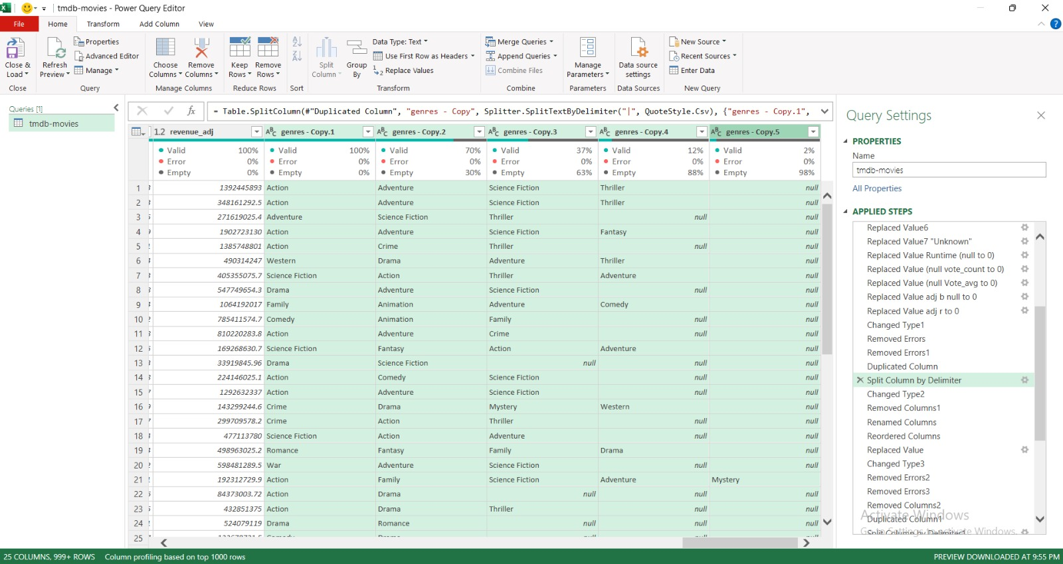
I took a copy of the movie genre and divided it and took the first column and deleted the rest

Slide 23
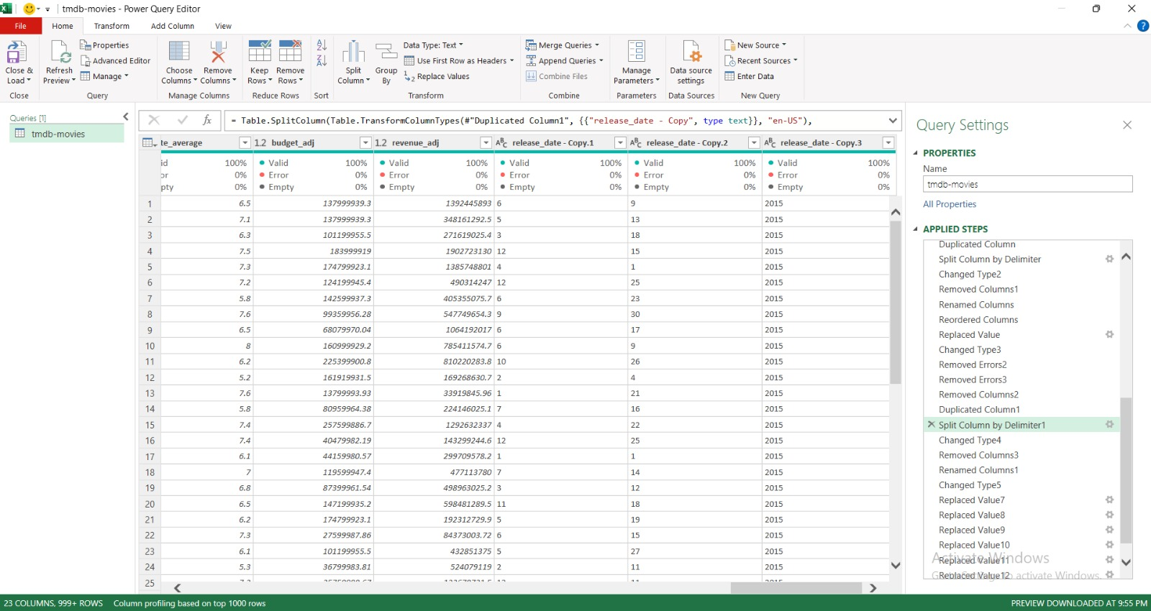
There was an error appears in the years column after changing the movie genre, so I deleted it and created a new one from the date column.

Slide 24
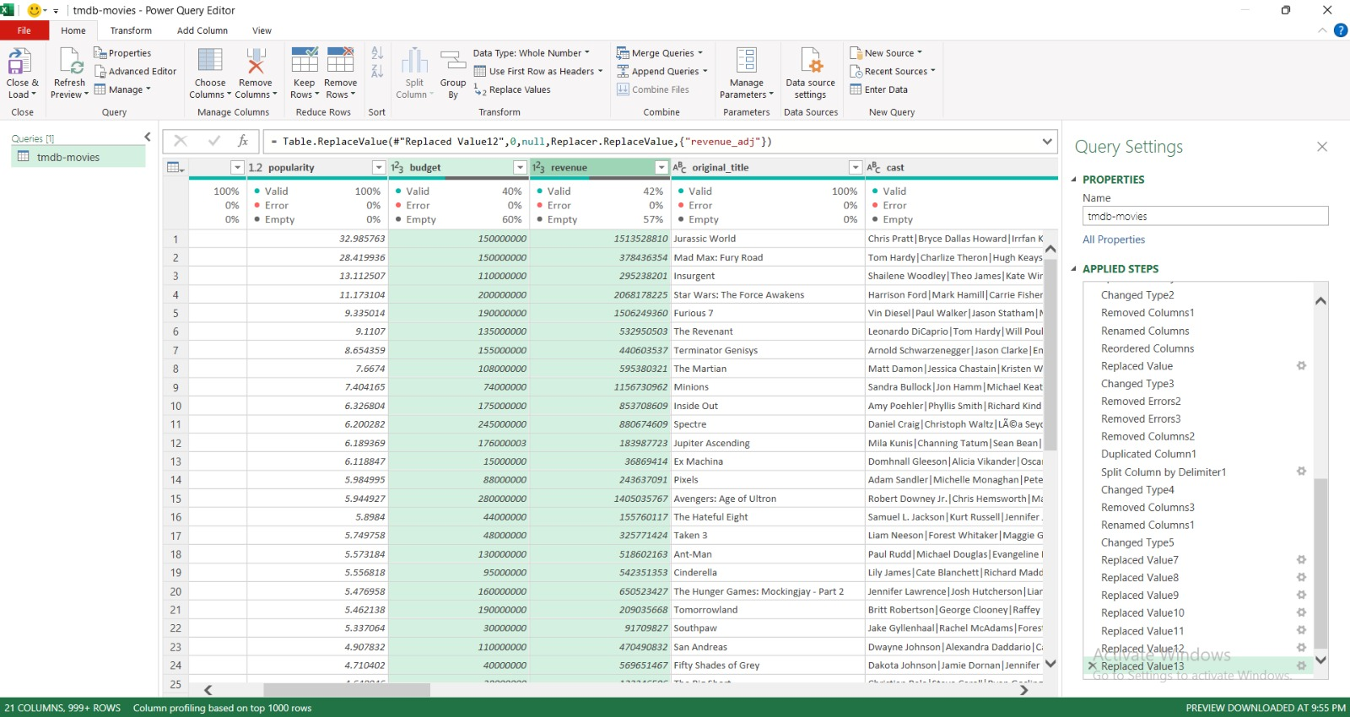
Here we Replace all 0 in our data to Null

Slide 25

Pivot Table
Average
Median

Slide 26
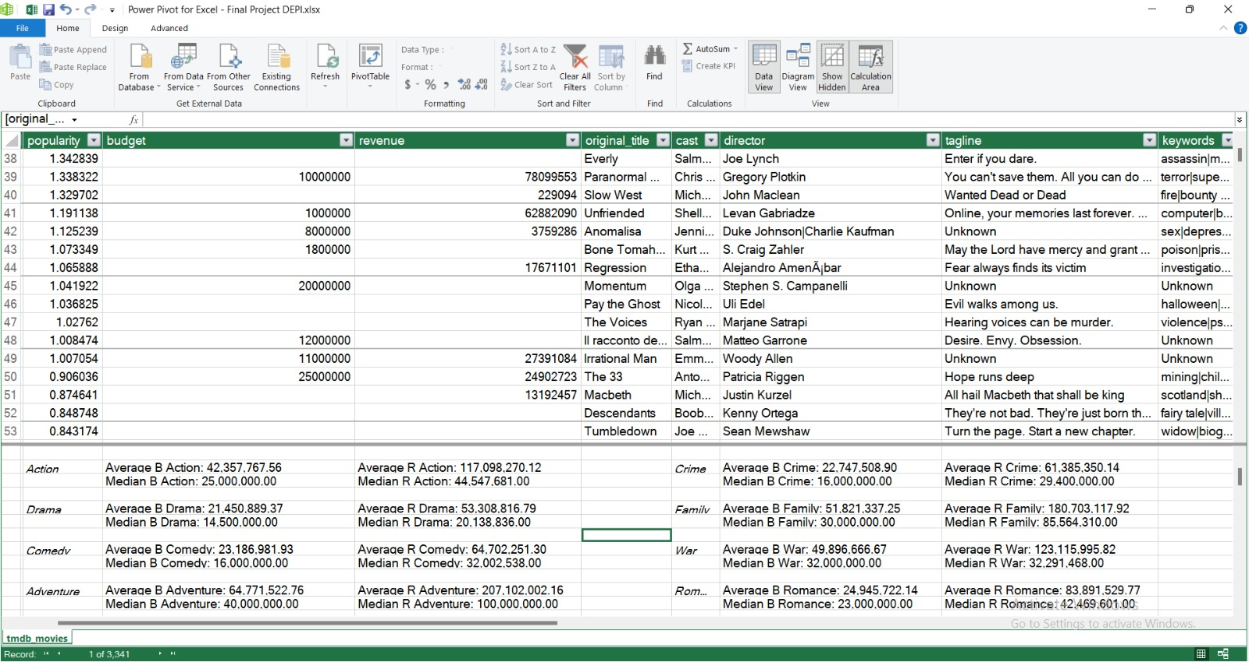

Slide 27
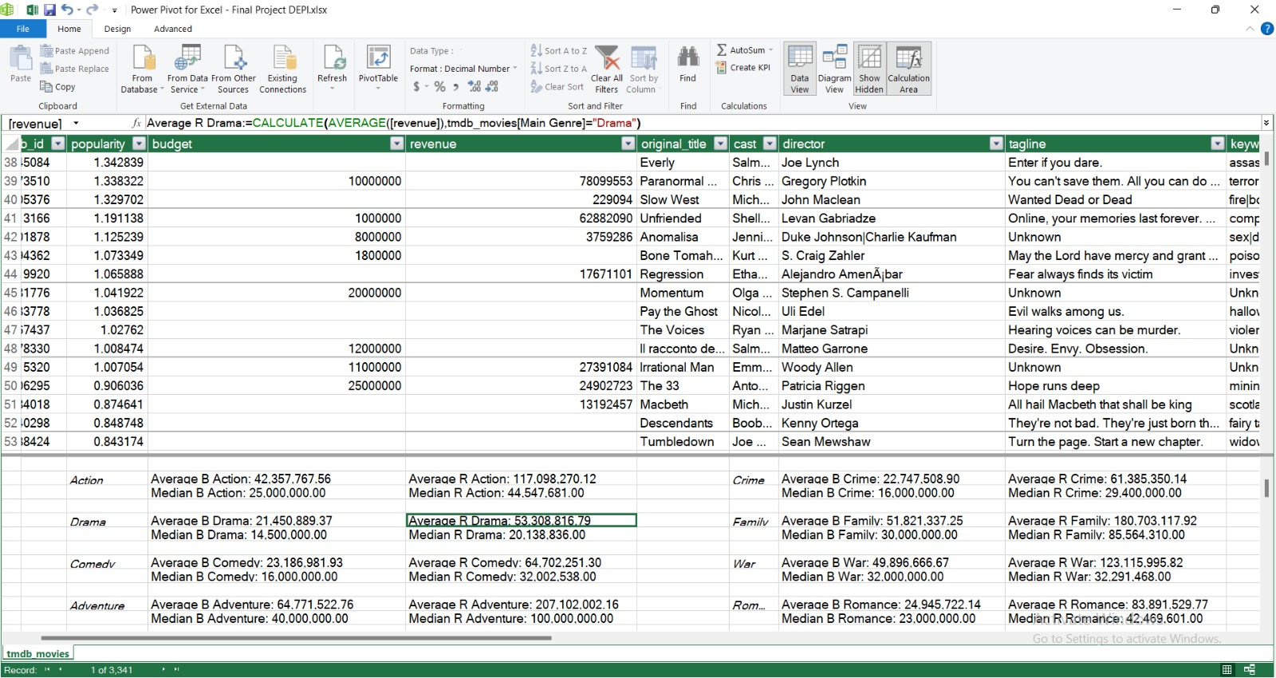

Slide 28
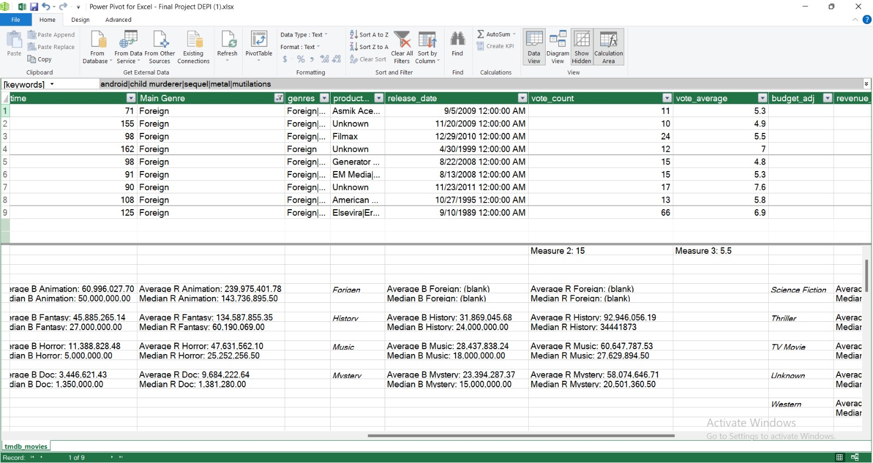

Slide 29

Be Aware
This measurement is based on real data, so we use it in our code.

Slide 30
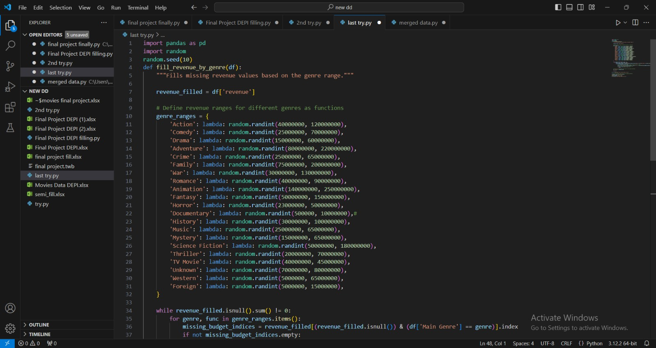

Slide 31
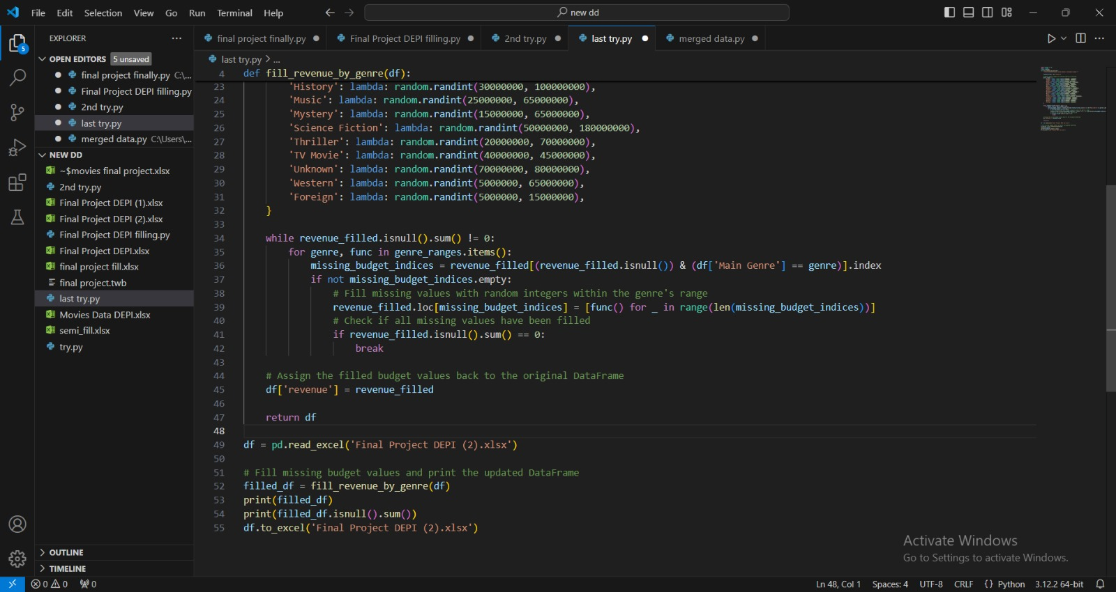

Slide 32
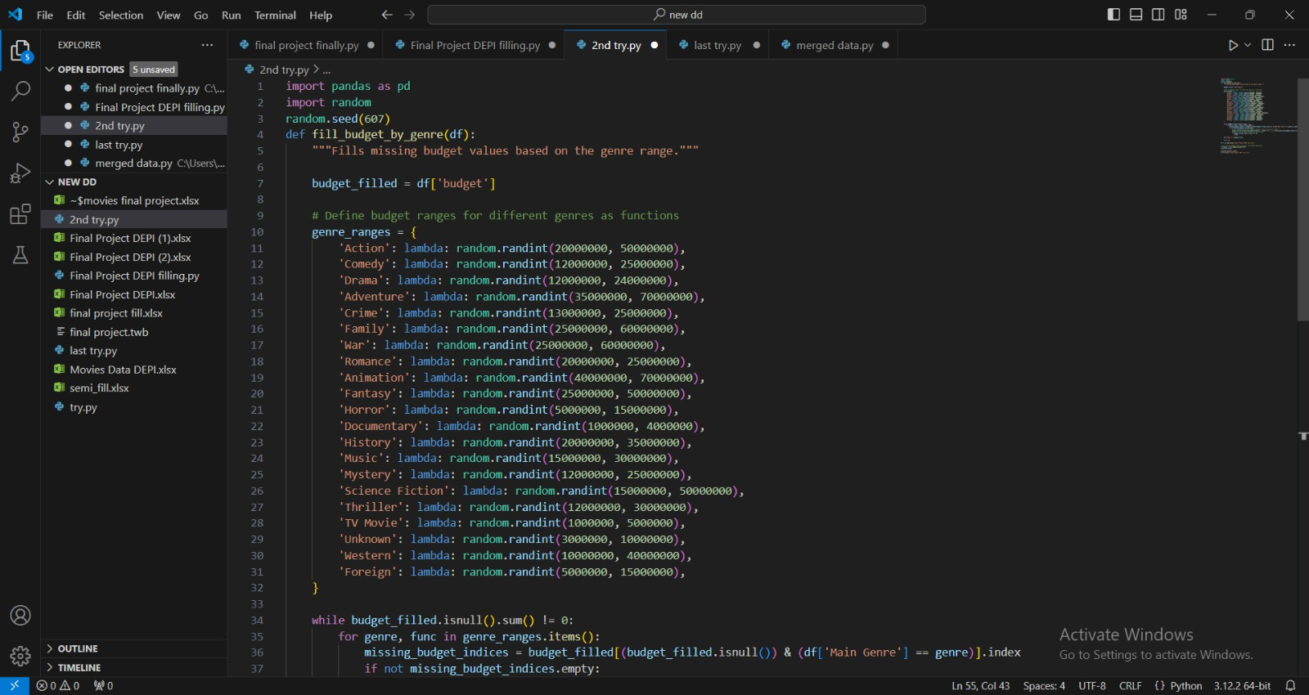

Slide 33
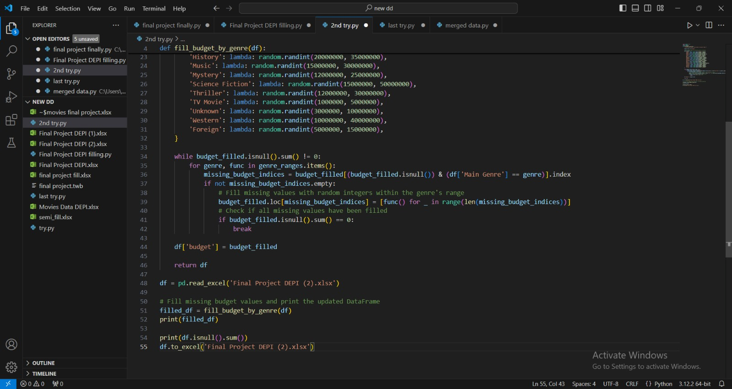

Slide 34
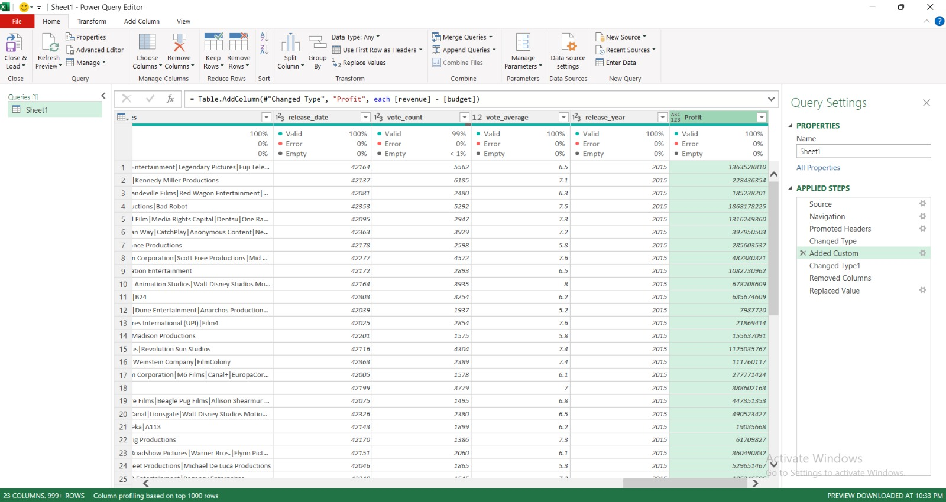
We add a new Row to calculate Profit

Slide 35

Visualization

Slide 36
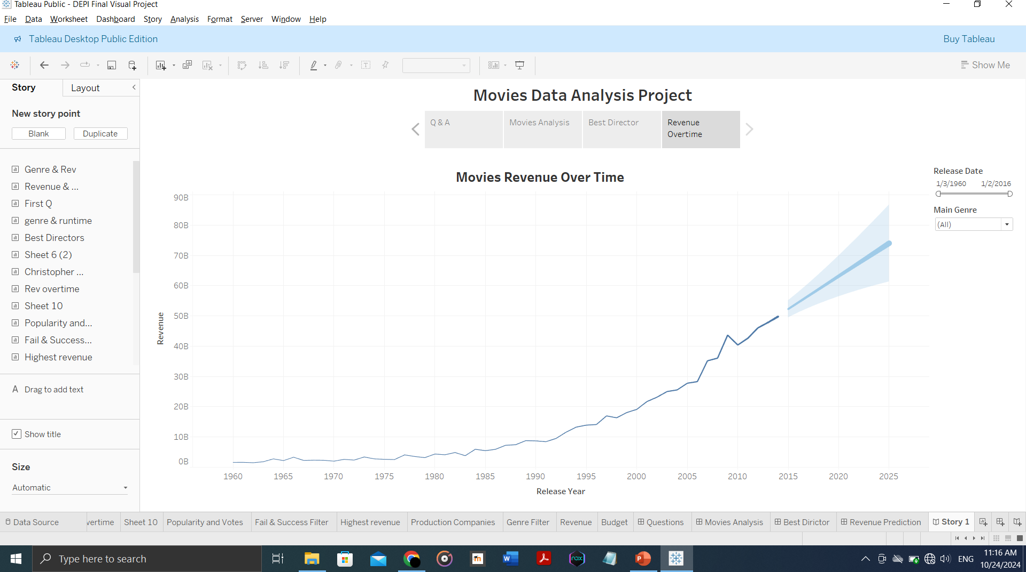

Slide 37
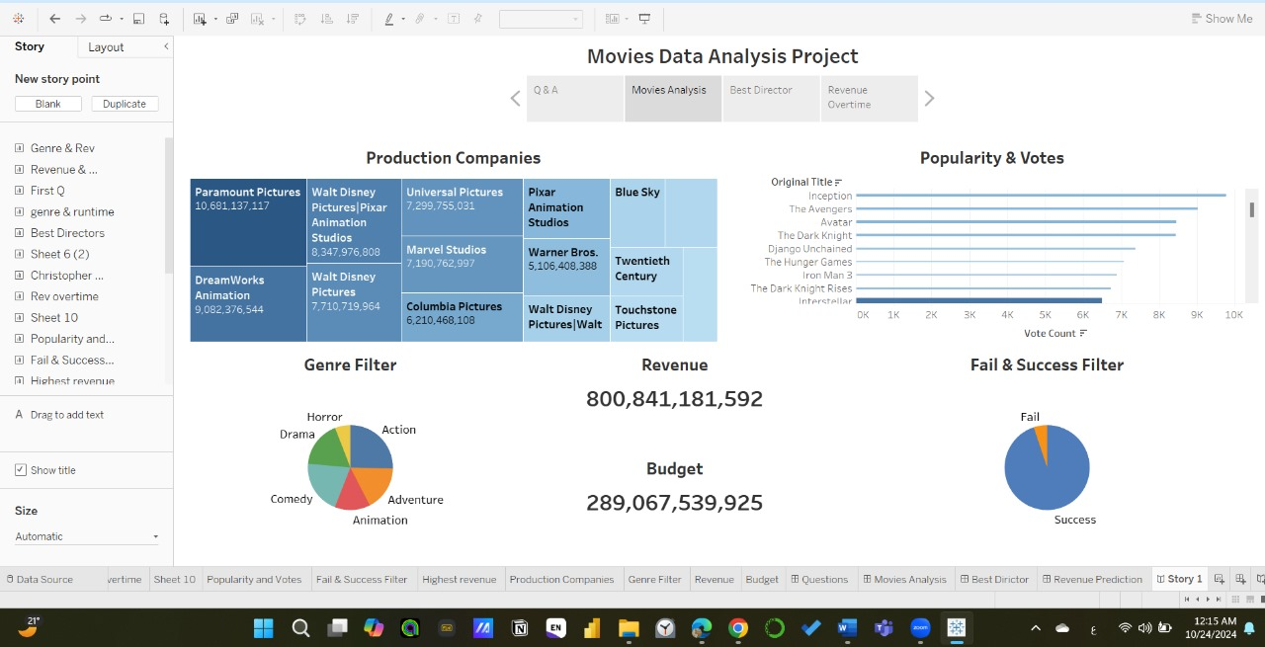

Slide 38
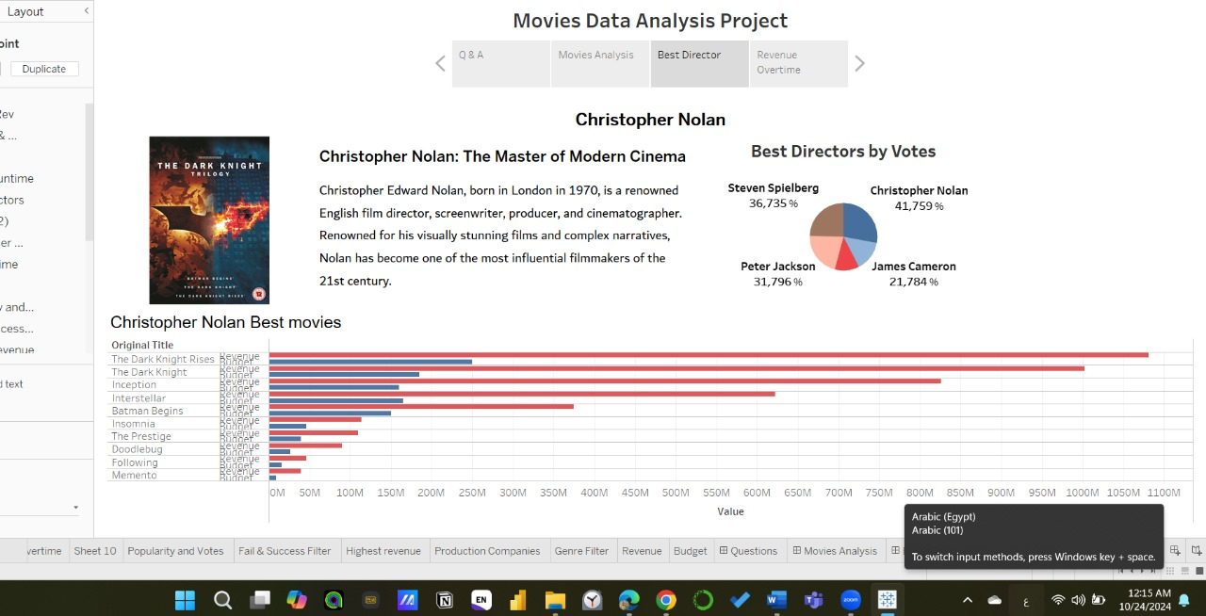

Slide 39
Thanks!
Do you have any questions ?

